Slide 1

Domain: MATLAB
Technology: COMMUNICATION
CLASSIFICATION OF 41 HAND AND WRIST MOVEMENTS VIA SURFACE ELECTROMYOGRAM USING DEEP NEURAL NETWORK

Slide 2
Index
Abstract
Introduction
Literature review
Existing Method
Disadvantages
Proposed method
Advantages
Applications
Hardware and Software Requirements
References

Slide 3
Abstract
Surface electromyography is an easy, non-invasive technique that allows the user to actively control the prosthesis (sEMG). However, the categorization of hand and wrist motions using sEMG has generated a wide variety of results in earlier experiments, including the acquisition methodology and the number of classes, but not entirely. This research investigates the deep neural network strategy to categorize 41 hand and wrist movements based on the sEMG data. The Ninapro project's database, one of the largest public sEMG databases for cutting-edge hand myoelectric prosthetics, was utilized to train and evaluate the suggested models. For this study, two datasets were used: DB5 with a low-cost 16-channel, 200-Hz setup and DB7 with a 12-channel, 2 kHz design. Our technique achieved an overall accuracy of 93.87 1.49 and 91.69 4.68%, respectively, with balanced accuracy of 84.00 3.40 and 84.66 4.78% for DB5 and DB7. The Southampton Hand Assessment Procedure (SHAP), a clinically validated hand functional assessment technique, only considered the six primary hand motions based on the six prehensile patterns, but we still saw a performance improvement. Using only the SHAP movements in DB5, a balance accuracy of 94.48 2.55% and a classification accuracy of 98.82 0.58% were attained.
Keywords: Surface Electromyogram, Hand Movement Classification, Deep Neural Network, Prosthetic Hand, Ninapro Database.

Slide 4
Introduction:
Dexterous prosthetic hands with non-invasive sensors and machine learning control capabilities are now possible thanks to recent developments in sensor technology, mechatronics, signal processing, and GPU-equipped edge computing hardware. However, there are presently few actual uses for these prostheses and little acceptance of them by amputees. Control issues, poor abilities and dexterity levels, and the price of the prosthesis are a few of the main causes. Additionally, routinely misclassifying desired activities might result in frustration and the abandonment of prostheses (Biddiss and Chau, 2007; Ahmadizadeh et al., 2017). Therefore, it's crucial to achieve a high level of human-machine interaction dependability and resilience for user experience and their adoption of the prosthetic hand.
Recent research on the sEMG classification using a deep learning approach tends to gravitate toward using CNN to automatically learn the features from a raw signal. However, training a deep neural network generally requires a large amount of training data for it to converge and discover meaningful features, especially for CNN. Moreover, CNN has a relatively high memory cost and processing time, which may pose challenges when running on embedded systems with limited resources. For our experiment, we were concerned about the limited amount of training data for the classification of 41 movements. Also, we would like to investigate the feasibility of adopting an accurate deep learning approach that would be able to run on affordable hardware. Therefore, we chose to extract hand-crafted statistical features and feed them to our deep neural network (DNN) model for the classification.

Slide 5
Literature review:
S. NO | Journal Type with year | Authors | Title | Outcomes
1 | IEEE Robot. Autom. Mag. 24, 102–111, 2017 | Ahmadizadeh, C., Merhi, L.-K., Pousett, B., Sangha, S., and Menon, C. | Toward Intuitive Prosthetic Control: Solving Common Issues Using Force Myography, Surface Electromyography, and Pattern Recognition in a Pilot Case Study | Studied about the Force MG, Surface EMG, and Pattern Recognition in a Pilot Case Study
2 | Front. Bioeng. Biotechnol. 7:331 (2019) | Ahmadizadeh, C., Pousett, B., and Menon, C. | Investigation of Channel Selection for Gesture Classification for Prosthesis Control Using Force Myography: A Case Study | Studied about Channel Selection for Gesture Classification for Prosthesis Control Using FMG
3 | PLoS ONE 13:e203835 (2018) | Ameri, A., Akhaee, M. A., Scheme, E., and Englehart, K. | Real-time, simultaneous myoelectric control using a convolutional neural network | Studied about Real-time, simultaneous myoelectric control using a CNN
4 | Nature 1:140053 (2014) | Atzori, M., Gijsberts, A., Castellini, C., Caputo, B., Mittaz Hager, A.-G., Elsig, S., et al. | Electromyography data for non-invasive naturally-controlled robotic hand prostheses | Studied about the EMG data for non-invasive naturally-controlled robotic hand prostheses

Slide 6
Existing methods:
Based on a public dataset of inexpensive sEMG sensors named Ninapro DB5, this research describes a Deep Neural Network approach for the categorization of 41 hand, wrist, gripping, and functional movements. Dexterous prosthetic hands with non-invasive sEMG sensors and control capabilities of machine learning are now possible thanks to recent developments in sensor technology, mechatronics, signal processing techniques, and edge computing hardware equipped with GPU. The technology is, however, out of reach for the majority of people due to its expensive cost. The purpose of this work is to investigate the capabilities and control of a low-cost sEMG sensor configuration for a prosthetic hand. Two Thalmic Myo armbands are used in the acquisition configuration for a total of 16 channels at a sampling rate of 200 Hz.
The acquisition setup includes two Thalmic Myo armbands for the total of 16 channels with the sampling rate of 200 Hz. Our approach achieved an overall accuracy of 91% with a macro recall of 77% for the classification of 41 movements, outperformed other algorithms such as SVM, Random forest, and XGBoost. These results suggest that a development of practical prosthetic hand could be possible with low-cost sEMG sensors.

Slide 7
Disadvantages in Existing methods:
Proposed DNN very good at classification but takes more time for training.
Proposed DNN is not very accurate compared to new classifiers available.
Feature extraction is not including minute details which results in less accurate

Slide 8
Proposed method:
In this study, surface electromyogram data are used to identify 41 hand movements using a deep neural network model. The publicly accessible datasets Ninapro DB5 and DB7 were used as low sampling rate data and high sampling rate data, respectively, for our analysis. DB5 was acquired using two Thalmic Myo armbands with 16 input channels and a 200 Hz sampling rate, and DB7 was acquired using Delsys Trigno electrodes with 12 input channels and a 2 kHz sampling rate.
We used the Southhampton Hand Assessment Procedure in addition to studies for the classification of the six movements based on the six prehensile patterns for assessing hand functionality (SHAP). When compared to other investigations' categorization findings, our proposed model outperformed the best results from Pizzolato et al. (2017) and Krasoulis et al. (2018)'s previous studies (2017). This is an encouraging outcome, even if greater support from a larger study with more data samples would surely be useful.

Slide 9
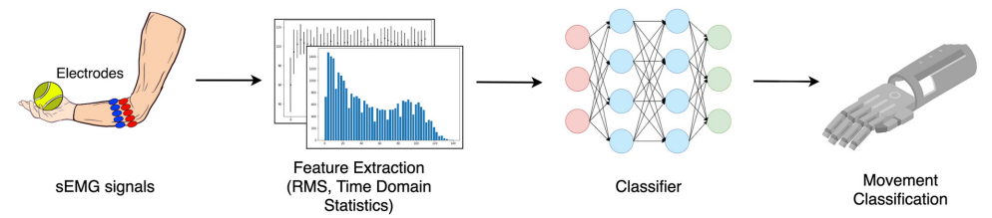
Flow of the proposed method

Slide 10
Advantages of Proposed method:
Proposed CNN based classifier is very good at classification.
Proposed classifier takes less time for training.
Proposed classifier is very accurate compared to existing classifiers.
Feature extraction is includes even the minute details which results in more accurate.

Slide 11
Applications:
Bio-Medical applications
Signal Processing
Machine Learning environments
Image Processing

Slide 12
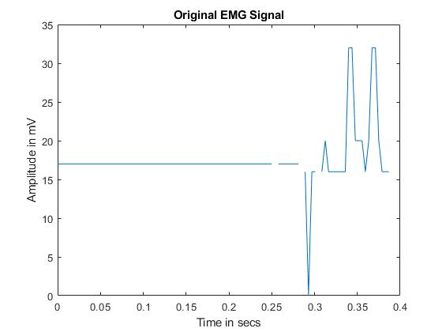
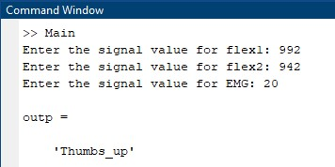
Results:

Slide 13
Hardware and Software Requirements:
Hardware & Software Requirements:
Software: Matlab R2018a.
Hardware:
Operating Systems:
• Windows 10
• Windows 7 Service Pack 1
• Windows Server 2019
• Windows Server 2016
Processors:
Minimum: Any Intel or AMD x86-64 processor
Recommended: Any Intel or AMD x86-64 processor with four logical cores and AVX2 instruction set support
Disk:
Minimum: 2.9 GB of HDD space for MATLAB only, 5-8 GB for a typical installation
Recommended: An SSD is recommended a full installation of all Math Works products may take up to 29 GB of disk space
RAM:
Minimum: 4 GB
Recommended: 8 GB

Slide 14
References:
[1] Ahmadizadeh, C., Merhi, L.-K., Pousett, B., Sangha, S., and Menon, C. (2017). Toward intuitive prosthetic control: Solving common issues using force myography, surface electromyography, and pattern recognition in a pilot case study. IEEE Robot. Autom. Mag. 24, 102–111. doi: 10.1109/MRA.2017.2747899.
[2] Ahmadizadeh, C., Pousett, B., and Menon, C. (2019). Investigation of channel selection for gesture classification for prosthesis control using force myography: a case study. Front. Bioeng. Biotechnol. 7:331. doi: 10.3389/fbioe.2019. 00331.
[3] Ameri, A., Akhaee, M. A., Scheme, E., and Englehart, K. (2018). Real-time, simultaneous myoelectric control using a convolutional neural network. PLoS ONE 13:e203835. doi: 10.1371/journal.pone.0203835.
[4] Atzori, M., Gijsberts, A., Castellini, C., Caputo, B., Mittaz Hager, A.-G., Elsig, S., et al. (2014). Electromyography data for non-invasive naturally-controlled robotic hand prostheses. Nature 1:140053. doi: 10.1038/sdata.2014.53.
[5] Atzori, M., and Müller, H. (2015). Control capabilities of myoelectric robotic prostheses by hand amputees: a scientific research and market overview. Front. Syst. Neurosci. 9:162. doi: 10.3389/fnsys.2015.00162.

